Slide 1
Attacks on Smart Contracts

Slide 2
Class of vulnerabilities
Solidity
EVM (Ethereum Virtual Machine) bytecode
Blockchain

Slide 3
Vulnerabilities
Call to the unknown
A request (call) is done to a contract which does not exist at the contract address and a fallback function is instead executed. This fallback function can contain malicious code.
Exception disorder
Exceptions are not handled with consistency and users who believe that a transfer was successful due to no exceptions being thrown may be attacked (~28% of contracts do not control the return value of call/send functions, as such the amount of gas lost is limited by the upper bound only)

Slide 4
Vulnerabilities
Gasless send
The amount of gas set in the function call is 2300 units (of gas)
Calling an empty function at the contract D can allow it to execute an empty fallback with only 2300 units used
Type casts
No exception handling is thrown to the user in case of type mismatches
Example: if contract c is not a contract address, the call returns without executing any code without any error.

Slide 5
Vulnerabilities
Reentrancy
The fallback mechanism will allow the function to be re-entered (or called again), allowing for looping until all gas is used
Keeping secrets
Requires the use of cryptographic techniques to ensure that the contents are not read until a certain time
Immutable bugs
As data on the blockchain cannot be altered, if contracts on the blockchain had bugs, it would otherwise be permanent. One case scenario was the “DAO hack” (which was subsequently reversed by a hard fork).

Slide 6
Vulnerabilities
Ether lost in transfer
Ether sent to an address not claimed by a user (or a contract) is permanently lost
Stack size limit
The limit of the call stack size is 1024 frames and exceeding that throws an error. Attackers generate an almost full call stack and invokes the victim’s function. If the exception is not properly handled, the attack can succeed
Unpredictable state
As transactions on blockchains are not time-critical, the state of the contract at query and execution may be different (not order preserving). Additionally, miners may not include that transaction into the blockchain (selective mining). Additionally states can also be reverted if the transaction was on the shorter branch of the fork.

Slide 7
Vulnerabilities
Generating randomness
Malicious miners can make use of the generator seed to create a hash or the timestamp of some block that will appear in the blockchain in the future. This allows an attack on the blockchain with limited resources
Time constraints
Malicious miners can create a new block with the timestamp to a certain degree of arbitrariness (i.e. a tolerance of 900 seconds). If the miner holds a stake on a contract, he can gain an advantage by choosing a suitable timestamp.

Slide 8
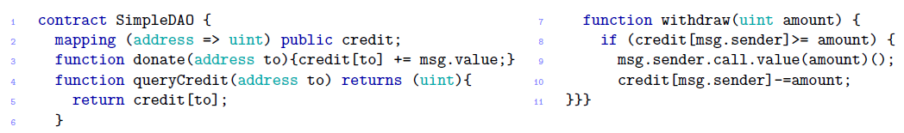
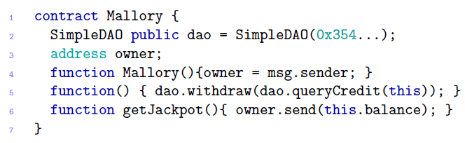
Exploit 1 (Simplified DAO Hack)
DAO Contract (Simplified):
Adversary Contract:
The attacker transfers some ether to the contract Mallory
1

Slide 9
Exploit 1 (Simplified DAO Hack)
DAO Contract (Simplified):
Adversary Contract:
Function() is executed, then the withdrawal function of DAO is called
2

Slide 10
Exploit 1 (Simplified DAO Hack)
DAO Contract (Simplified):
Adversary Contract:
The call function calls the function() and the contract Mallory again and goes into a loop
3

Slide 11
Exploit 1 (Simplified DAO Hack)
DAO Contract (Simplified):
Adversary Contract:
The function can only terminate if
Gas is exhausted
Call stack exceeds 1024 frames
Balance of DAO becomes 0
4

Slide 12
Exploit 1 (Simplified DAO Hack)
DAO Contract (Simplified):
Adversary Contract:
The contract then sends all the ether to the attacker using the getJackpot() function
5

Slide 13
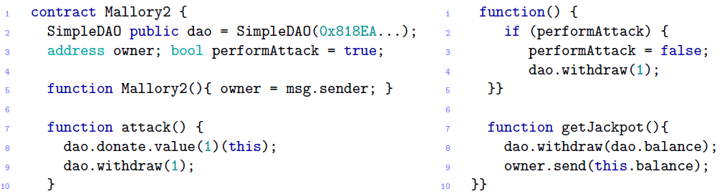
Exploit 2 (2-call DAO Hack)
DAO Contract (Simplified):
Adversary Contract:
1
The attacker donates 1 wei to the contract to execute the function

Slide 14
Exploit 2 (2-call DAO Hack)
DAO Contract (Simplified):
Adversary Contract:
2
This is then donated to the DAO (Value at DAO = 1 wei)

Slide 15
Exploit 2 (2-call DAO Hack)
DAO Contract (Simplified):
Adversary Contract:
3
This 1 wei is then withdrawn (Value at DAO = 1 wei, withdrawn = 1 wei)

Slide 16
Exploit 2 (2-call DAO Hack)
DAO Contract (Simplified):
Adversary Contract:
The fallback function is called before the amount is updated (Value at DAO = 1 wei, withdrawn = 1 wei)
4

Slide 17
Exploit 2 (2-call DAO Hack)
DAO Contract (Simplified):
Adversary Contract:
Another 1 wei is withdrawn
(Value at DAO = 1 wei, withdrawn = 2 wei)
5

Slide 18

Exploit 2 (2-call DAO Hack)
DAO Contract (Simplified):
Adversary Contract:
The amount is now updated at DAO: 1 wei – 1 wei * 2 withdrawals = -1 wei = $2^{256}$-1 wei (underflow because wei count is uint64)
6

Slide 19

Exploit 2 (2-call DAO Hack)
DAO Contract (Simplified):
Adversary Contract:
7
The function stack is closed
(Value at DAO = $2^{256}$-1 wei)

Slide 20

Exploit 2 (2-call DAO Hack)
DAO Contract (Simplified):
Adversary Contract:
getJackpot() is called to withdrawal $2^{256}$-1 wei or the balance of the entire DAO, whichever is lower
7

Slide 21
Exploit 2 (2-call DAO Hack)
DAO Contract (Simplified):
Adversary Contract:
8
The contract now sends the obtained balance to the owner

Slide 22
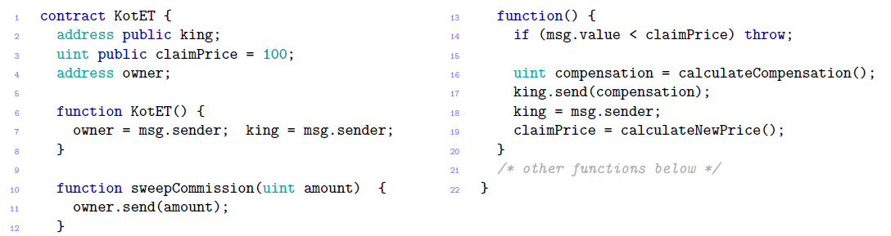
Exploit 3 (King of Ether throne)
Contract:
This game allows players to compete for the title “King of the Ether” by paying some ether + contract fee. The value increases monotonically.

Slide 23
Exploit 3 (King of Ether throne)
Contract:
1
By sending ether to the contract, the fallback function is initiated.

Slide 24
Exploit 3 (King of Ether throne)
Contract:
2
If the current “king” is overthrown, a compensation is given out

Slide 25
Exploit 3 (King of Ether throne)
Contract:
Because send() is used (and not checked for gas usage), we can intentionally make the transaction fail and the ether will be stored in the contract
3
Notes:
Send transaction need minimum 2300 gas*

Slide 26
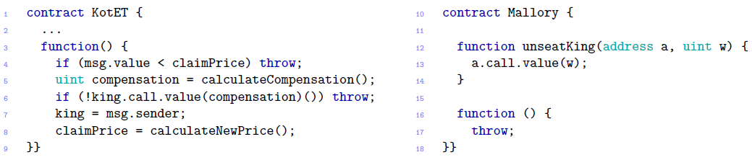
Exploit 3 (King of Ether throne)
Contract (Modified):
As call() is now used instead of send(), the contract is now honest.
It is however still subjected to denial of service
Notes:
Send transaction need minimum 2300 gas*

Slide 27
Exploit 3 (King of Ether throne)
Contract (Modified):
1
We introduce a contract Mallory to send the amount required for the owner to become king
Notes:
Send transaction need minimum 2300 gas*

Slide 28
Exploit 3 (King of Ether throne)
Contract (Modified):
When compensation is sent to unseat the contract Mallory, the contract throws an exception and denies the unseating
2
Notes:
Send transaction need minimum 2300 gas*

Slide 29
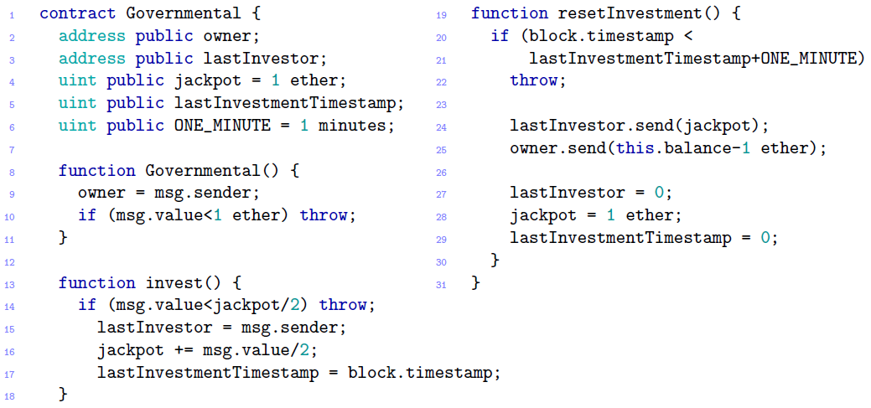

Exploit 4 (GovernMental: Ponzi Scheme)
Contract: Account array:
Each participant must send ether to participate. If no one joins after 12 hours, then the ether is sent to the last participant. After that, the arrays are cleared.
Notes:
Send transaction need minimum 2300 gas*

Slide 30
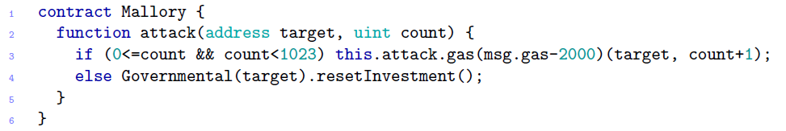
Exploit 4 (GovernMental: Ponzi Scheme)
Exploitation:
1
When the contract is executed, the contract exploits 1024 frame call stack
Notes:
Send transaction need minimum 2300 gas*

Slide 31
Exploit 4 (GovernMental: Ponzi Scheme)
Exploitation:
2
At frames 0 to 1022, it calls itself recursively to make the stack size increase
Notes:
Send transaction need minimum 2300 gas*

Slide 32
Exploit 4 (GovernMental: Ponzi Scheme)
Exploitation:
3
At frame 1023, the resetInvestment() function is called
Notes:
Send transaction need minimum 2300 gas*

Slide 33
Exploit 4 (GovernMental: Ponzi Scheme)
Contract:
4
The resetInvesment() function sends the last jackpot, but fails as frame 1024 is an overflow.
Notes:
Send transaction need minimum 2300 gas*

Slide 34
Exploit 4 (GovernMental: Ponzi Scheme)
Contract:
5
The contract state is now reset for another round and all existing ether remains in the contract
Notes:
Send transaction need minimum 2300 gas*

Slide 35
Exploit 4 (GovernMental: Ponzi Scheme)
Contract:
6
For the owner to withdraw, the owner only needs to wait for a round to terminate correctly
Notes:
Send transaction need minimum 2300 gas*

Slide 36
Mitigations: Verify Smart Contracts
Presented are some of the more serious vulnerabilities in the implementation of smart contracts
Tools can be used to detect vulnerabilities in the smart contract source code.
Oyente is one tool that extracts the control flow graph from the EVM bytecode of the contract and executes it to detect vulnerability patterns (especially “exception disorder”, “time constraints”, “unpredictable state”, and “reentrancy”/recursion.
Oyente does this by translating smart contracts from Solidity/EVM bytecode to F*

Slide 37
References
Atzei, N., Bartoletti, M., & Cimoli, T. (2017, April). A Survey of Attacks on Ethereum Smart Contracts (SoK). In International Conference on Principles of Security and Trust (pp. 164-186). Springer, Berlin, Heidelberg.

